Slide 1
Income Classification
Arjun Singh
Amith Prasad
Vivan D’souza

Slide 2
Outline
EDA
Modification
Build a Model
Evaluate the Model

Slide 3
Exploratory Data Analysis (EDA)
The dataset contains 18 features and 31,588 observations
There are 33,349 NA values out which Tax Paid has 29,206 NAs
The target variable is categorical and has 2 levels
Choosing Logistic Regression as the model of choice

Slide 4
Modification
Removed the Index column.
Converted Loan taken and target to categorical values.
Checked the NA values in the train data set and found 33349 NA values.
Checked the NA values more than 20% and found 25 rows greater than 20% and Imputed those rows.
Checked column-wise NA’s and found tax paid has 29,181 NA values.
In tax paid column – either converted all the NA’s to zero’s and values to 1’s or omitted them
The same procedure has been followed for the test data.

Slide 5
Build a Model
Splitted the train data into train and validation by 70/30.
Built a logistic regression model by using glm function.
Step-AIC removed insignificant features like Index, Loan Taken etc.,
Measured Accuracy, Sensitivity and Specificity

Slide 6
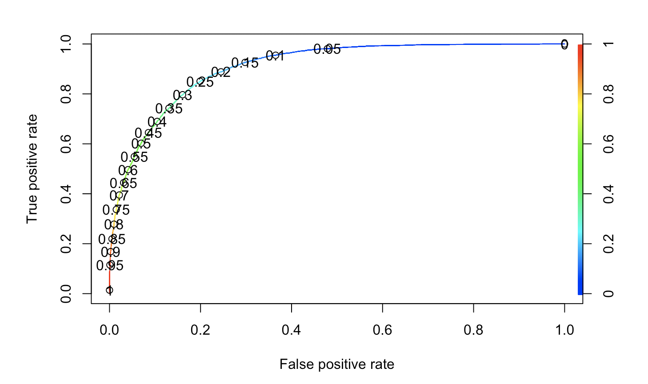
ROC Curve
AUC | 90.73%

Slide 7
Prediction and Evaluation on the validation data
Predicted the validation data by using the threshold value 0.5.
Evaluated the model by using confusion matrix.
Specificity – 93.58% [TN/(TN+FP)]
Sensitivity – 58.34% [TP/(TP+FN)]
Accuracy – 85.24% [(TP+TN)/(TP+TN+FP+FN)]
Also ran Step AIC to remove insignificant features

Slide 8
Conclusion
The model classifies with 84.32% whether the income of the population is low or high.

